Slide 1
Food and Beverage Industry Analysis in Power-BI
Mentorness Task 3
–Nevil Hitesh Mehta

Slide 2
Agenda
Familiarising with Data
Current Task
Data Modeling
Data Cleaning
Data Analysis
Data Visualization
Insights
Conclusion

Slide 3
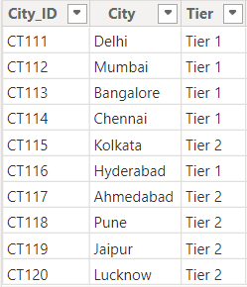
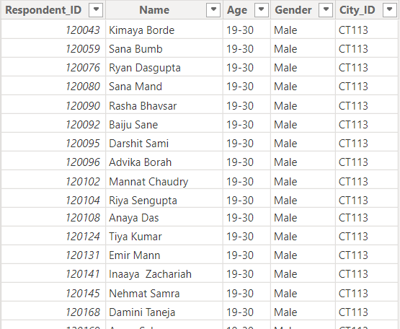
Raw Data
City
Respondents

Slide 4
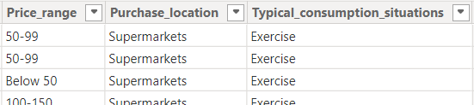
Raw Data
Survey Responses

Slide 5
Key Observations
Two Dimensions and one Fact table
Dimension Tables: City, Respondents
Fact Table: Survey Responses
Data-type of most variables: Categorical
City connected with Respondents: One-Many
Respondents connected with Survey Responses: One-One

Slide 6
Task at Hand
To identify key trends
To understand brand perception
To explore potential areas for improvement in product offerings, marketing strategies.

Slide 7
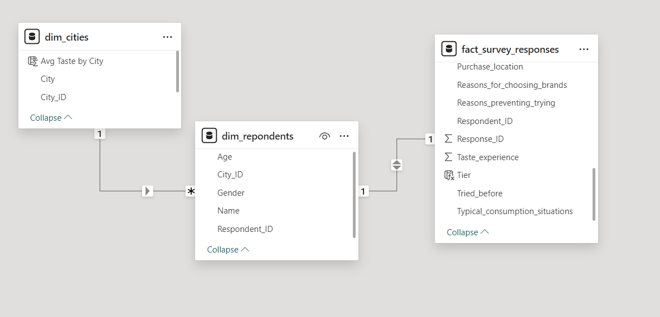
Data Modeling

Slide 8
Data Cleaning
Checking Data-type of every variable
Checking for Duplicate values (Respondent ID)
Checking for Null values
Modifying variable names (To boost performance -> Performance, 2-3 times a Week-> Bi-Weekly, etc)

Slide 9
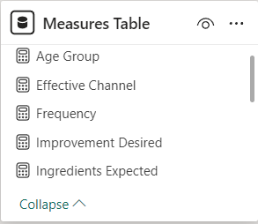
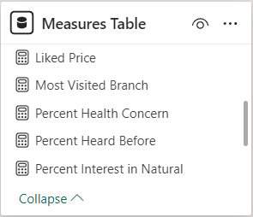
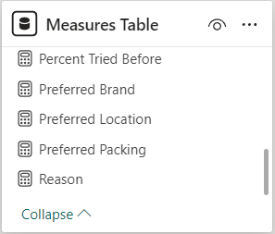
Data Analysis
Adding City, Tier, Age and Gender columns to Fact table (Denormalization).
Creating a separate Measures table.

Slide 10
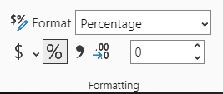
Data Analysis
Measures: Categorical and Numerical
Numerical: Calculating percentage composition among the total.

Slide 11
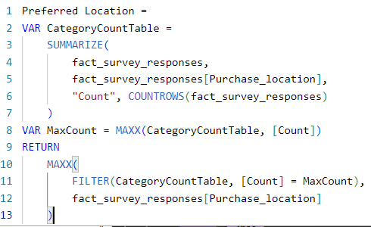
Data Analysis
Categorical: Identifying labels corresponding to maximum count.

Slide 12
Data Visualization
Layout: 4 Reports
Overview: Analysing Cities, Brands, Age Groups, Tiers
Product Information: Analysing product preference among respondents.
Consumption Pattern: Identifying trends and analysing consumer behaviour.
Marketing Strategy: Analysing different marketing strategies and assessing their effectiveness.
Elements: Cards, Slicers, Bar-charts, Doughnut Charts, Tree Map, Choropleth Map

Slide 13
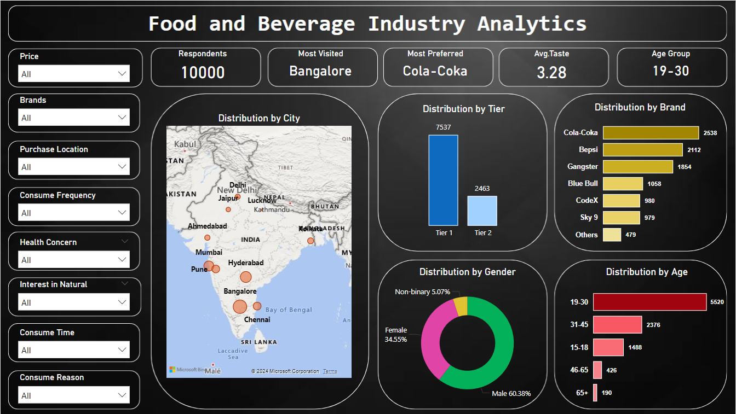
Overview

Slide 14
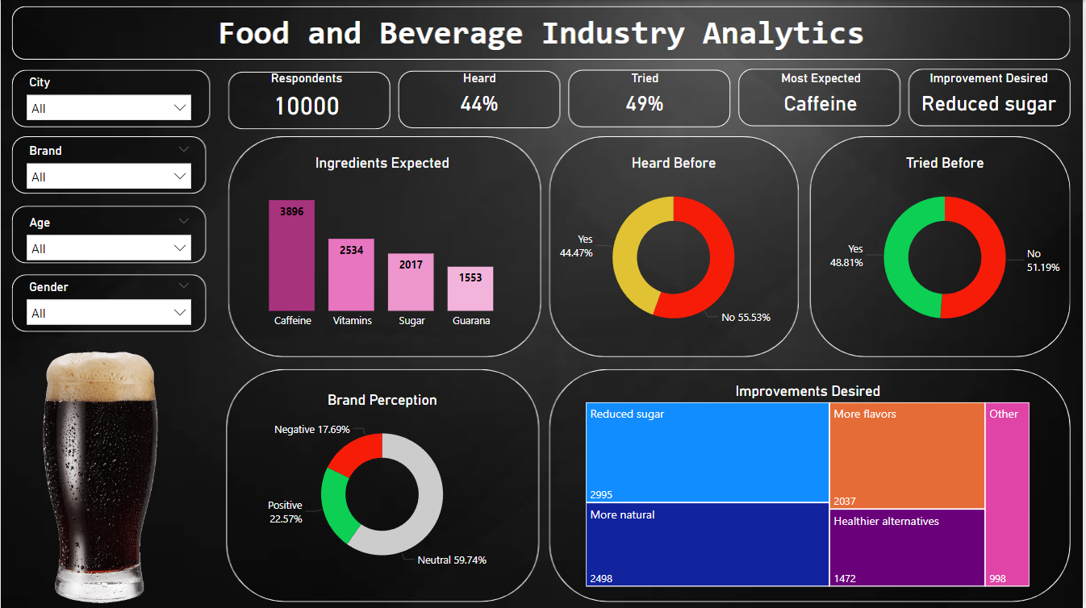
Product Information

Slide 15
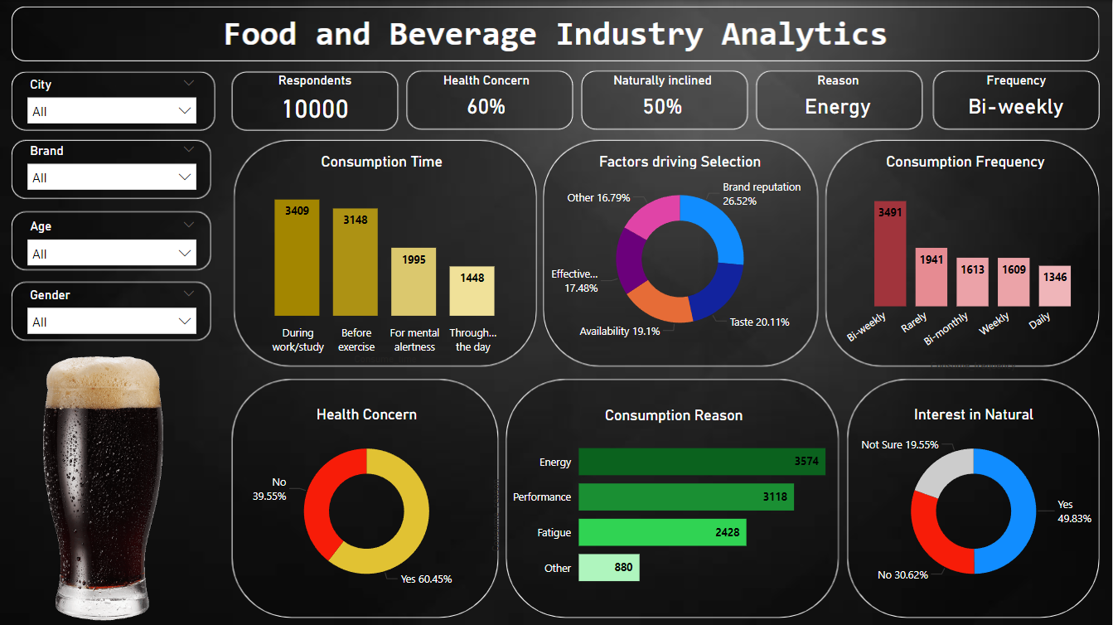
Consumption Pattern

Slide 16
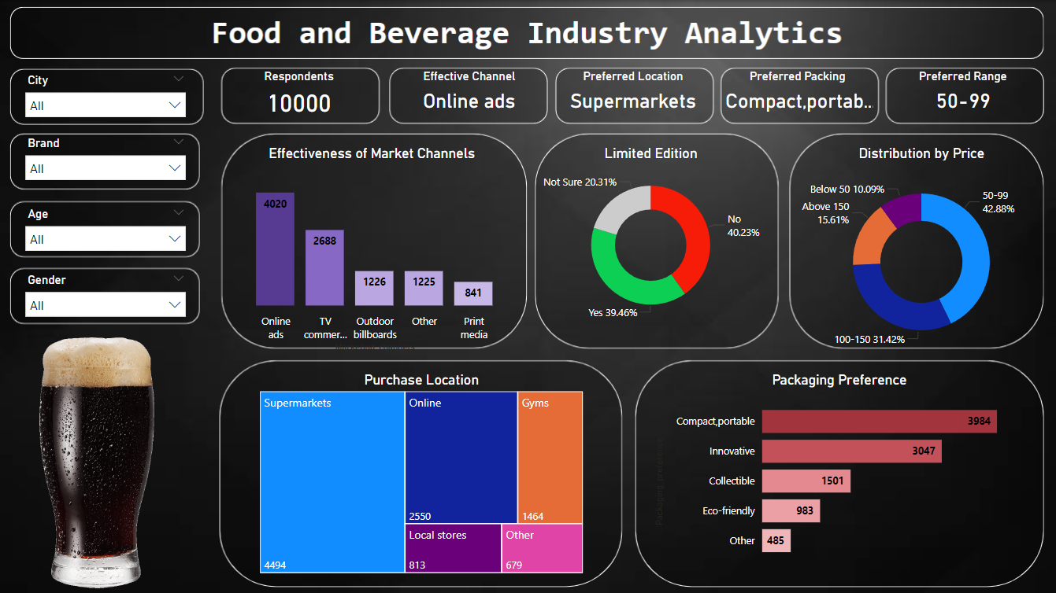
Marketing Strategy

Slide 17
Insights:Demographics
75% of Respondents are from Tier 1.
55% belong to the age-group of 19-30.
60% of respondents showing interest in beverages are Males.
Bangalore in Tier 1 and Pune in Tier 2 have high respondents.

Slide 18
Insights:Product Information
Brand reputation: Major factor driving beverage selection.
Cola-Coka(25%) is most popular among respondents followed by Bepsi(21%).
Caffeine: Most expected ingredient
Reduced Sugar: Most desired improvement.
45% have heard out of which 50% have actually tried the beverage.
Most of the respondent have neutral perception towards brands.

Slide 19
Insights:Consumption Pattern
65% consume for increasing energy and improving performance required during work, study or before exercise.
Around 35% consume 2-3 times in a Week.
Daily: Chennai, Delhi, Jaipur; Weekly: Hyderabad
Bi-weekly: Mumbai, Pune, Bangalore.
Men: increasing energy, Women: combating fatigue, improving performance.
60% are health concerned.
50% have shown interest in natural and organic product.

Slide 20
Insights:Marketing Strategies
Online Ads: Most effective for Southern Cities.
TV-Commercials:Most effective for Northern Belt.
45% respondents prefer to buy from Supermarkets.
50-99 is the preferred price range.
Being compact and portable is most seen factor in terms of packaging.

Slide 21
Recommendations
Target Consumer: Youth from Tier 1 Cities.
Target Locations:
Mumbai, Pune, Delhi, Jaipur, Bangalore, Chennai
Stock audit on daily and weekly basis w.r.t branches.
Product Goals:
Variety in existing flavours with increased Caffeine, reduced Sugar.
Increase brands of healthy, natural energy drinks
Marketing Goals:
Simple packaging with affordable price.
Online Reach: Social Media Ads, Commercials of Supermarket chains.

Slide 22
Thank You

